Slide 1
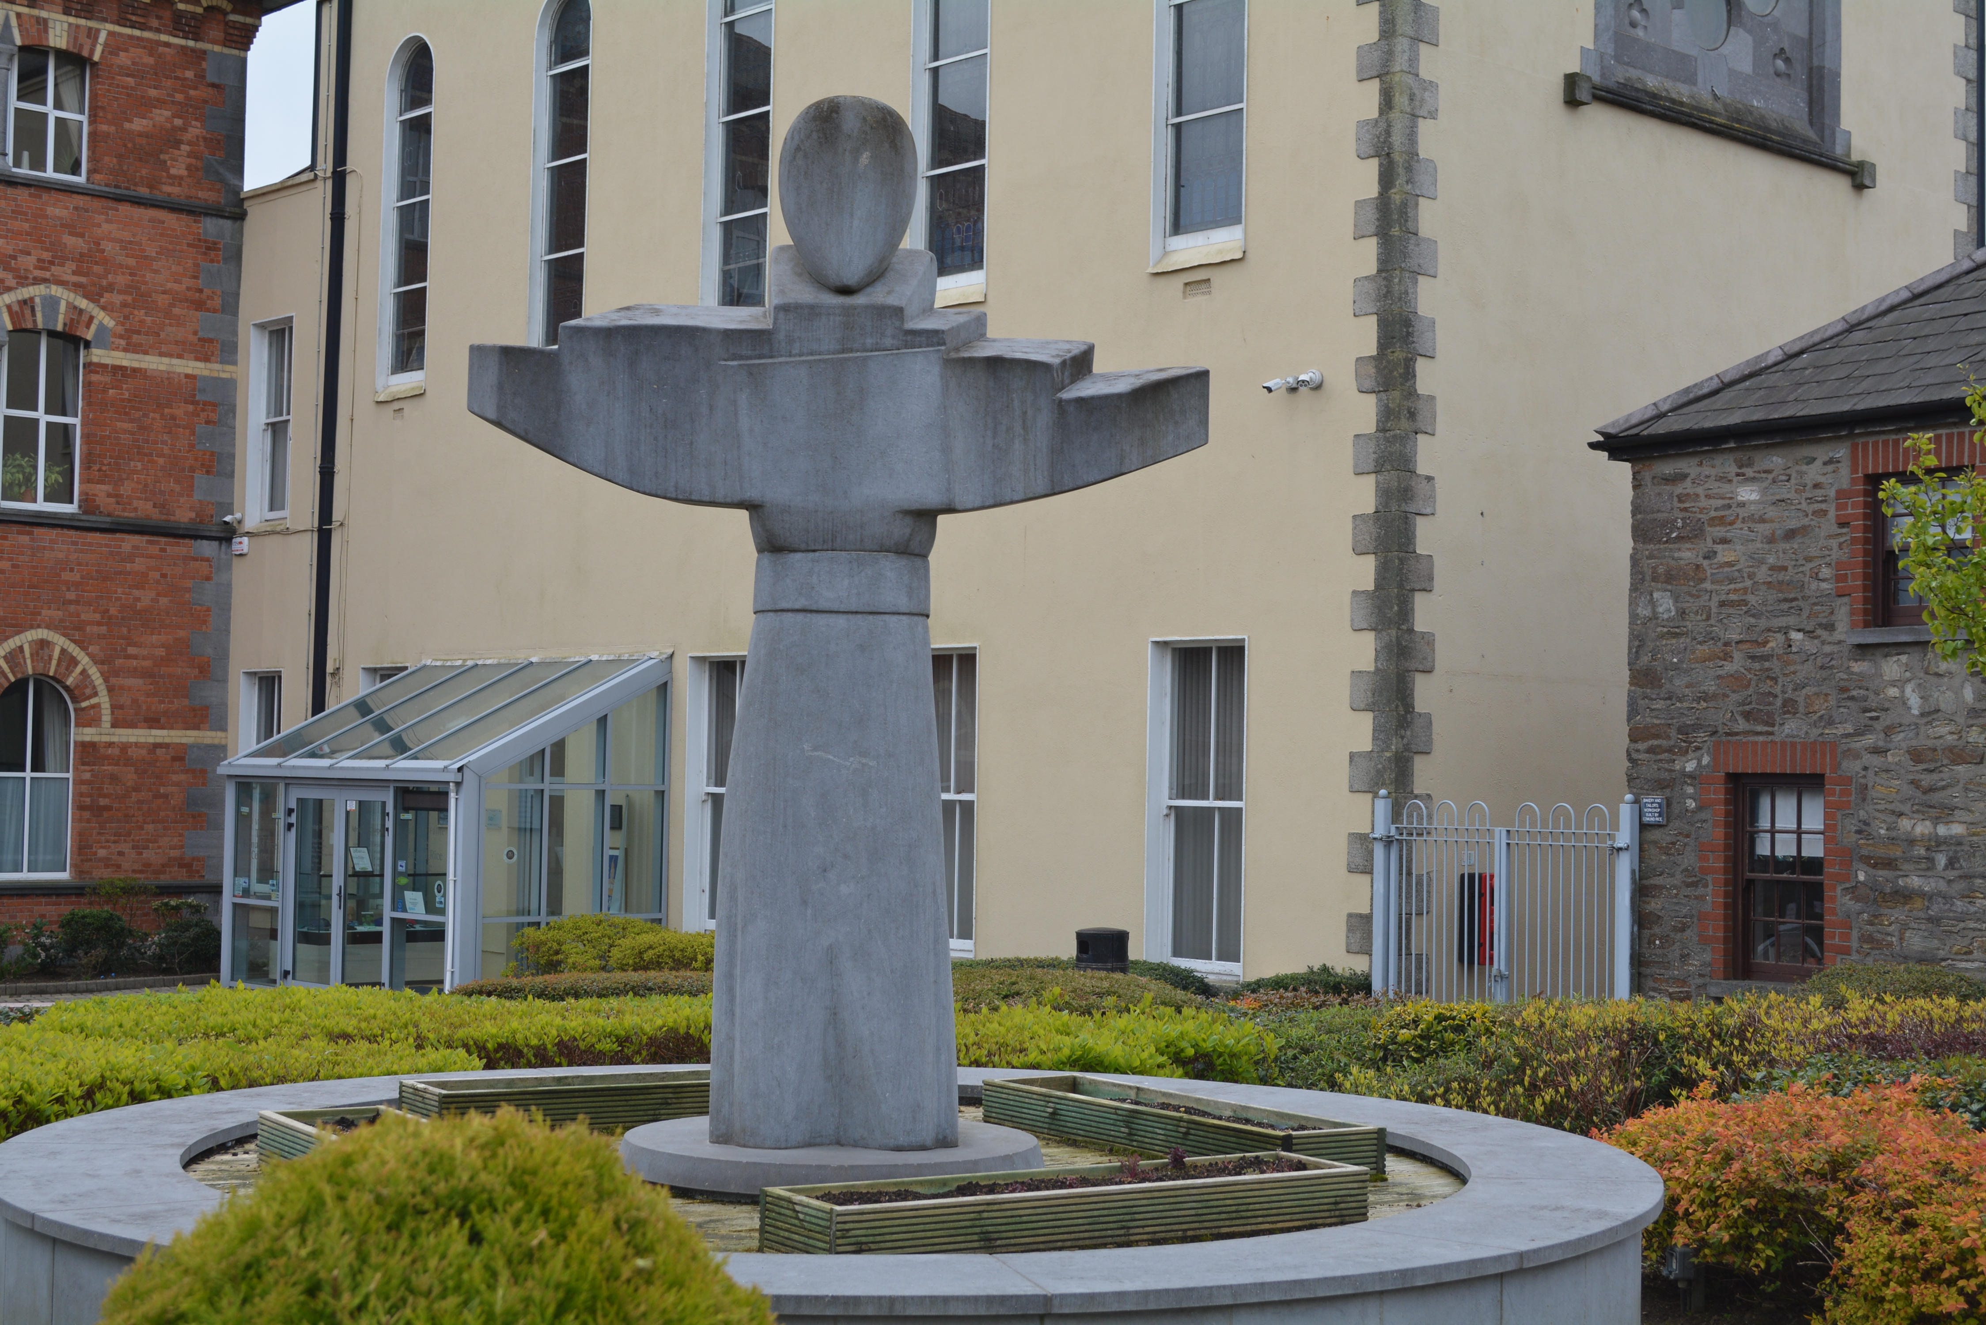
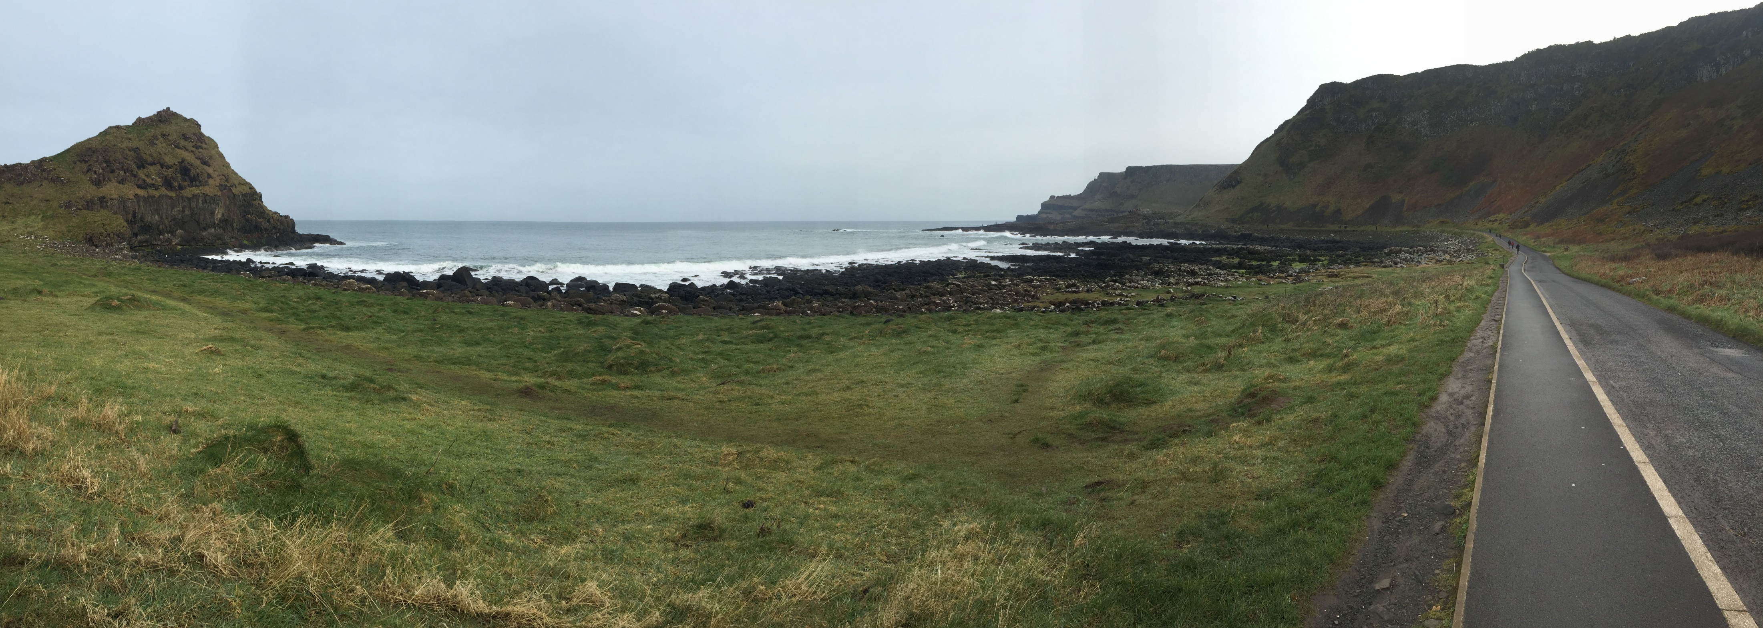
Dates:
IRELAND TOUR 2024
Departing Melbourne: Tuesday, March 26
Arriving Melbourne: Friday, April 12

Slide 2
Tonight’s Meeting
Welcome: Mr Steven O’Connor
Tour Schedule: Mrs Leonie Spencer
Parent Tour: Mr Terry Simpson
Application Process/Timeline: Mr Howard Clark
Payment Schedule: Mr Howard Clark
Fundraising: Mr Howard Clark
Criteria: Mr Howard Clark

Slide 3
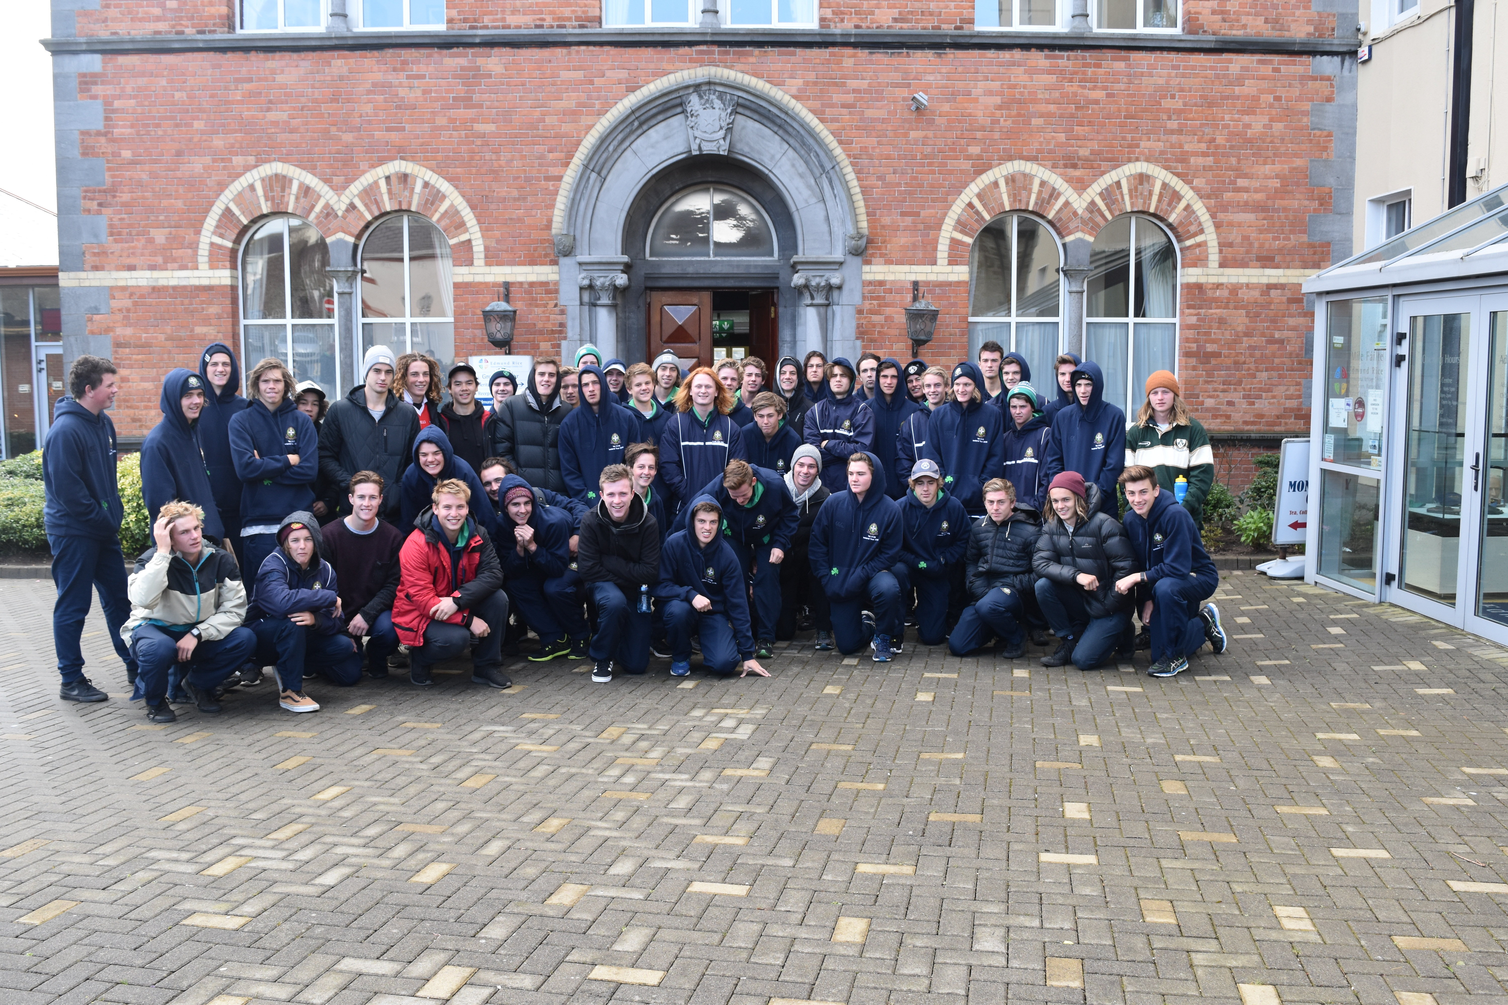
Introduction
St Patrick’s College through its flagship First XVIII football programme is offering an opportunity for students to tour Ireland and London in the Term 1 holidays in 2024.
This tour, in line with the football strategic plan follows successful trips to Ireland (2007, 2010,2013, 2016 & 2019), Darwin (2008, 2011 & 2014, 2017) and Melbourne (2006, 2009, 2012, 2015, 2018, 2021 & 2024)
The tour aims to play a series of 4 International Rules games in Dublin, Cork, Galway and Maghera (Northern Ireland)

Slide 4
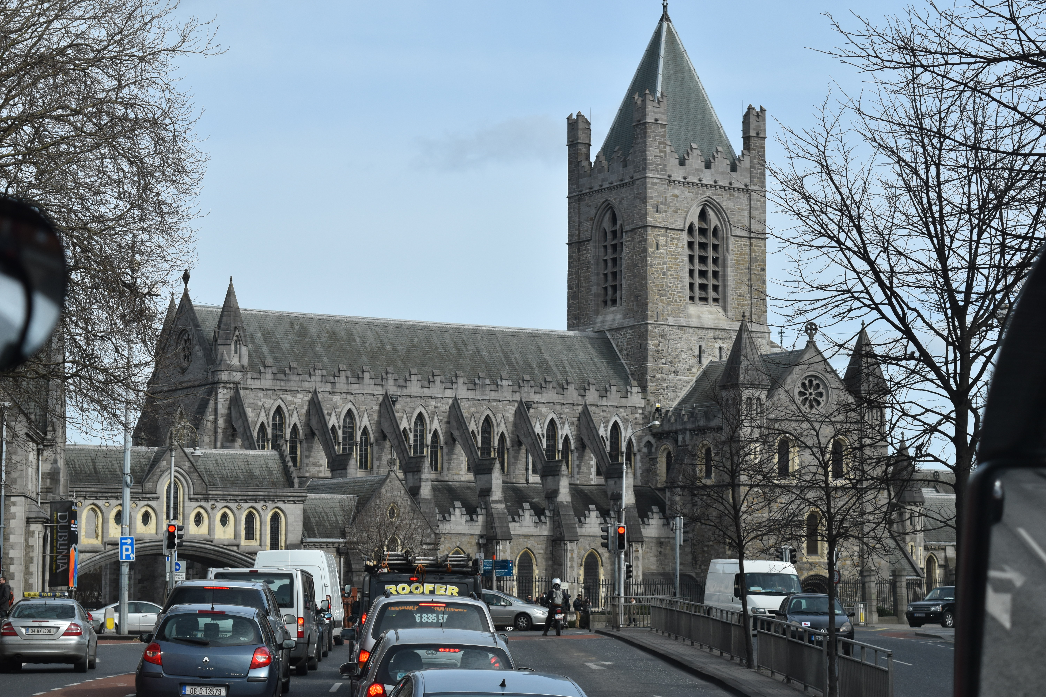
Leonie and Simon Spencer: Lifestyle Travel
Proposed itinerary
Ireland
Places of interest
Book of Kells
Blessed Edmund Rice – Waterford & Callan
Kissing the Blarney Stone
Visiting Adare, The Cliffs of Moher, and the Burren
Walking tour of the murals of Derry
World heritage listed Giants Causeway
Belfast: the Titanic Museum
4 games of International Rules: Dublin, Cork, Galway and Maghera (Nth Ireland)

Slide 5
Leonie and Simon Spencer: Lifestyle Travel
Proposed itinerary
London
Buckingham Palace, Trafalgar Square, Big Ben, London Eye
Chelsea Football Club,
MCC (Lord’s Cricket Oval)
West End Theatre
Potentially and EPL or Championship game (pending availability)
Western Front

Slide 6
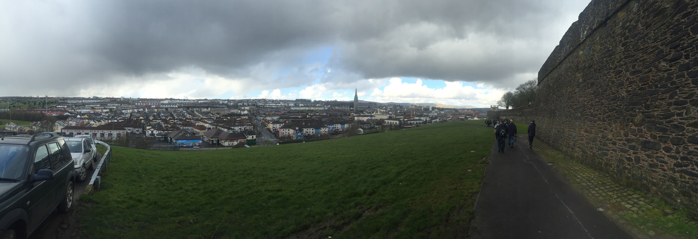

Video Summary
Tour Video Mp4.mp4

Slide 7
Terry Simpson: Parent Tour
Leonie Spencer from Lifestyle Travel will be offering a Parent tour to both Ireland and London and will travel the same route and at the same time as the student tour. The Parents/friends will attend each of the four international rules games in Dublin, Cork, Galway and Maghera (Nth Ireland) whilst also having several opportunities to meet up with their son throughout the 17-day period. For those adults interested in this opportunity, Leonie can be contacted on:
leonie@lifestyletravel.com.au

Slide 8
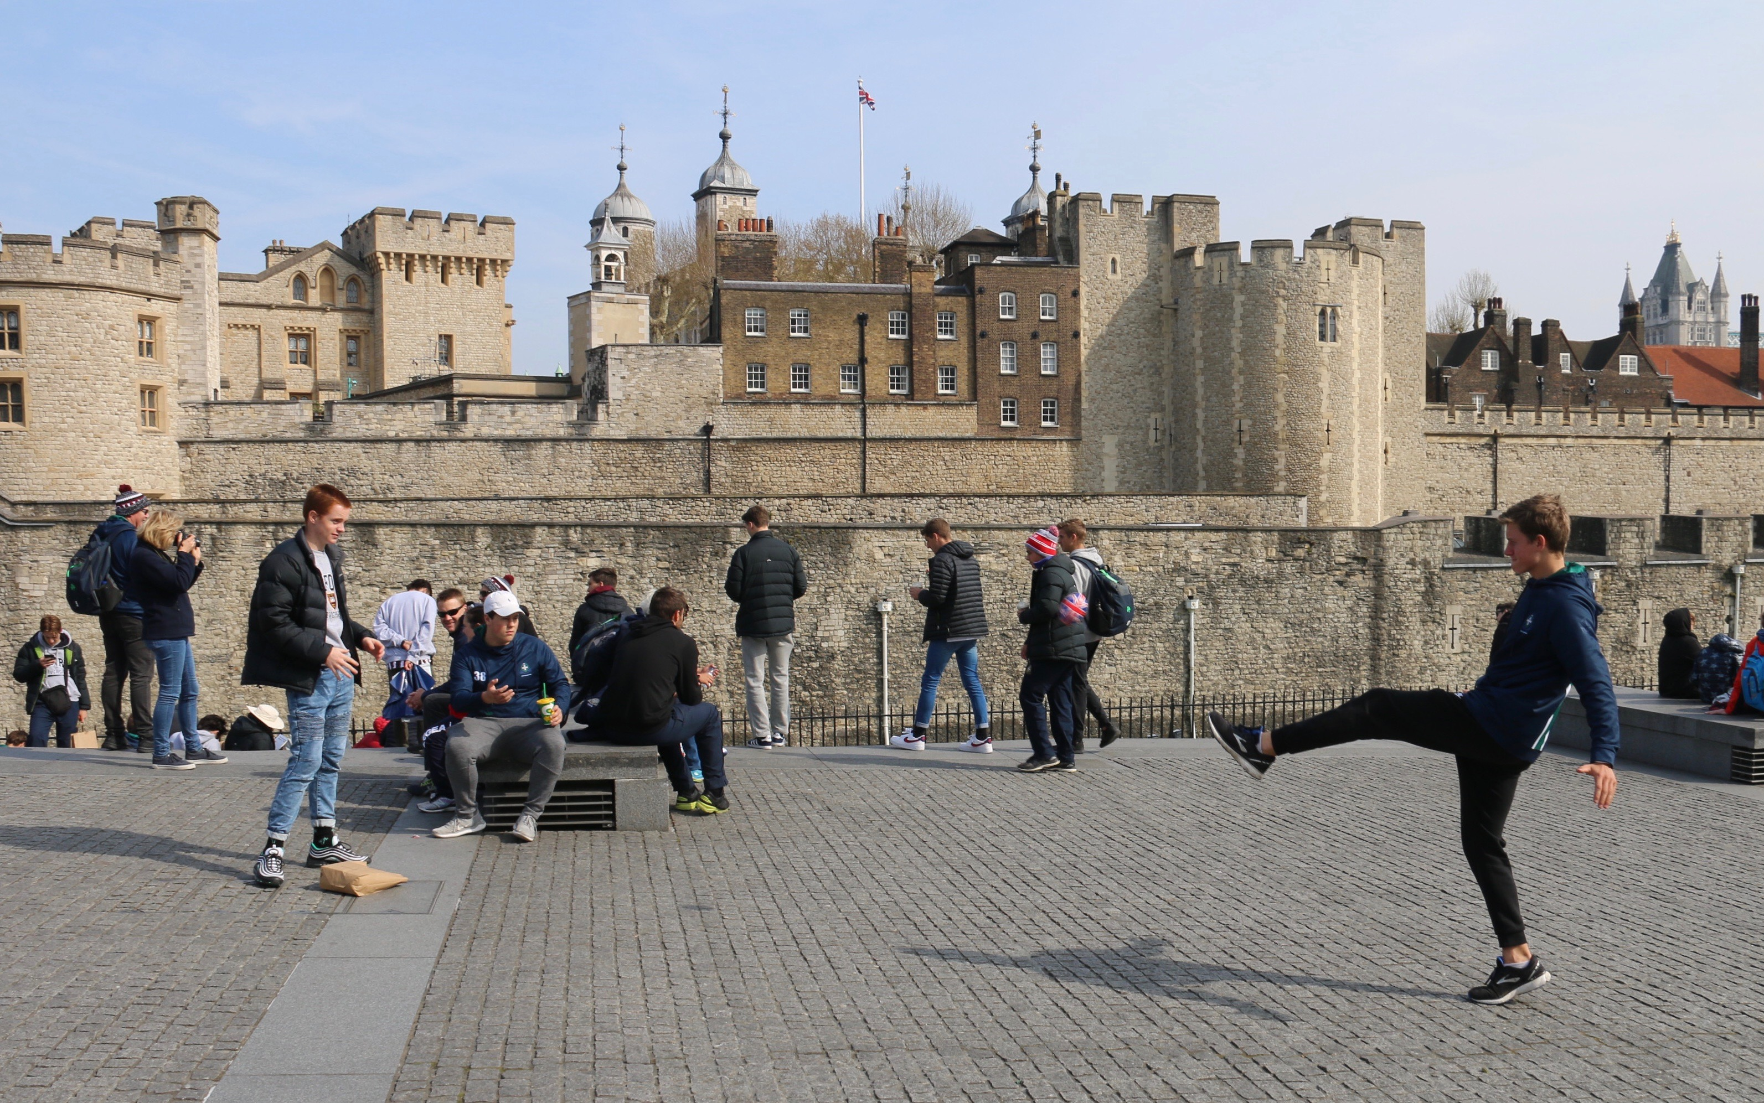
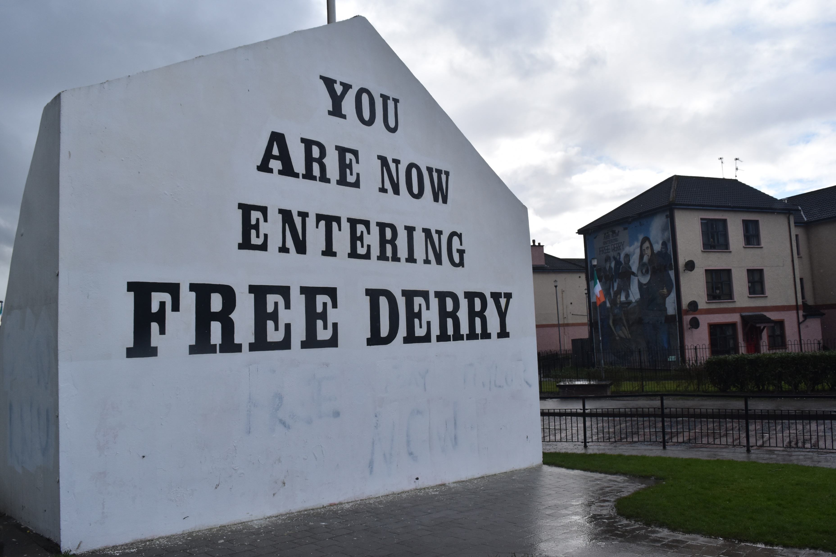
Application Process https://www.surveymonkey.com/r/KCZ3TMP
Applications open: Monday, June 5
Applications close: Monday, July 10
Letter of offer: Monday, July 17

Slide 9
Fundrasing
Hosting of students from Shibuya High School, Tokyo
Film Night, Regent Theatre,
Outdoor Cinema on our Main Oval
If you are interested in being a member of a fundraising committee, please contact Howard Clark: hclark@stpats.vic.edu.au

Slide 10
Payment Schedule
Proposed payment schedule for tour.
The final schedule to be determined after costing’ are finalised however it is expected the cost of the tour to be no more than $10,000
July 31, 2023: Tour deposit $1000 (as part of application process, refundable if student is unsuccessful in obtaining a position on the touring party)
October 6, 2023:1st Instalment $2500 (on successful application)
October 27, 2023: 2nd Instalment $2500
November 17, 2023:3rd Instalment $2500
February 1, 2024 Payment Balance $1500 (to be confirmed)

Slide 11
Criteria
Behaviour within St Patrick's College
Commitment to SPC Football
National Representation
State Representation
U/18 Coates Talent League (GWV Rebels, Bendigo Pioneers or Western Jets)
1ST XVIII SPC Jumper
U/16 GWV Rebels, Bendigo Pioneers or Western Jets selection
1st XVIII ACC Game
Interleague Representation

